Slide 1
Chapter 15
Review and Tips
Introduction to CFX

Slide 2
Domain Interfaces
Domain Interfaces can be used as part of a meshing strategy as well as for connecting different domains or reference frames together
Boundary conditions are created in each domain when a Domain Interface is created; generally you should not edit these directly
When the mesh is different on each side of the interface a GGI (General Grid Interface) is used
  This will use more memory in the Solver than a continuous mesh
  Accuracy across a GGI interface is usually not a concern as long as the mesh length scales on each side are similar
Automatic Domain Interfaces are created by CFX-Pre in some cases
  Always check these and don’t assume that all the required Domain Interfaces have been created

Slide 3
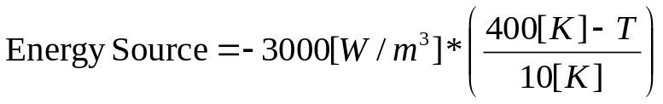
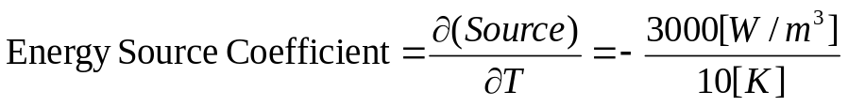
Sources
Sources are used to account for physics or processes that have not been directly resolved in the simulation
Momentum sources can be used to create a pressure drop (e.g. a screen, a porous material) or a pressure rise (e.g. a fan)
Energy sources can account for heat added/removed from the simulation
When sources are functions of the solved variable (e.g. momentum sources that are functions of velocity, energy sources that are functions of temperature) the Source Coefficient should be set
  The Source Coefficient must be negative otherwise the solver will diverge
  May need to re-write the Source so that is has a negative derivative

Slide 4
Transient Simulations
In a transient analysis the timestep should be small enough to capture the transient behaviour of interest
Boundary conditions can be functions of time
Convergence should be monitored so that each timestep is converged
  It is generally better to reduce the overall timestep size to improve convergence rather than increasing the number of coefficient loops
Remember to create the Transient Results object before running

Slide 5
Turbulence
Estimate the flow Reynolds Number to determine if the flow is laminar or turbulent
Check y⁺ values to make sure the near-wall mesh is suitable
  y⁺ < 300 for a Wall Function solution
  y⁺ <=2 with the SST model for a low-Re solution
The SST model is a good choice for a general turbulence model
Be aware of the limitations of the turbulence model chosen
  RANS models resolve the mean flow field, therefore a lot of transient turbulent structures are not captured
    These may be important when simulating noise and vibration
  The k-ε model can give inaccurate separation predictions

Slide 6
Heat Transfer
High speed flows (Mach > 0.2) should use the Total Energy model
The double precision setting for the Solver is recommended for CHT simulations (i.e. when a solid domain is included)
Always make sure energy imbalances have reached acceptable levels in CHT cases
Enable Viscous Work or Viscous Dissipation if heating due to viscous effects is important
If thermal radiation is modeled choose an appropriate model depending on the optical thickness
Thin Wall modeling and thermal contact resistances can be set at domain interfaces

Slide 7
Moving Zones
Moving boundaries can be simulated in several different ways
For rotating walls, a wall velocity can simply be imposed if the motion is purely tangential (e.g. a rotating hub or a solid brake disk)
When the rotating walls have a normal component of velocity they must be placed inside a rotating domain (e.g. blades, vented brake disk)
  Stationary walls then become counter-rotating in the rotating domain and must form surfaces of revolution (i.e. no normal component of velocity)
  Although a Mesh Motion approach is possible, it is much more computationally expensive
Mesh motion is usually used to simulate deforming boundaries or linear / cyclic motion

Slide 8
Moving Zones
At a change in reference frame a frame change model is used
  From low fidelity/cost to high fidelity/cost the choices are Frozen Rotor, Stage or Transient Rotor Stator
Other approaches for moving regions are:
  Rigid Body Motion
    A 6-DOF solves calculates the solid body motion
    Used in conjunction with Mesh Motion
  Immersed Solid
    Used to simulate moving solids that cannot be accommodated with Mesh Motion

Slide 9
Why Does My Case Fail in the Solver?
First carefully read the error message
  The error message may recommend setting an Expert Parameter
  This may be an appropriate fix, or it may mask an underlying problem
    Example:
    +--------------------------------------------------------------------+
    | Checking for Isolated Fluid Regions |
    +--------------------------------------------------------------------+
    2 isolated fluid regions were found in domain R1
    …
    …
    turn off this check by setting the expert parameter "check isolated regions = f".
    This error usually means domain interfaces are missing, so setting the expert parameter would not usually be appropriate

Slide 10
Why Does My Case Fail in the Solver?
“Insufficient Memory Allocated” type errors
  First check the .out file to see which process was running (Solver, Partitioner or Interpolator)
  Increase the Memory Alloc Factor in the Solver Manager (Define Run >> enable Show Advanced Controls >> Solver / Partitioner / Interpolator tab)
“Not enough free memory is currently available on the system”
  A system limitation has been reached!
  “Memory” refers to RAM
  Possible solutions:
    Run in parallel or increase the number of partitions to distribute the memory load
    Reduce the memory requirements for the case
      Smaller mesh
      Fewer or smaller GGI interfaces

Slide 11
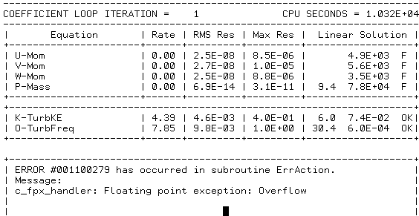
Why Does My Case Fail in the Solver?
“Floating point exception: Overflow”
  The solver has diverged
  Often some of the equations will
  show “F” instead of “OK” before
  the error message
  When this error occurs in the first
  few iterations perform some basic
  checks:
    Are the boundary conditions physical?
    What’s the Reference Pressure?
    What pressure is set at the boundaries?
    What’s the initial pressure?
    What direction would you expect the flow to go given the specified pressures?
  Reduce the timescale, particularly if the solver fails later in the run

Slide 12
Why Does My Case Fail in the Solver?
“Floating point exception: Overflow”
  Write out backup files before the
  failure and examine the solution
  fields (Pressure, Velocity, …)
    Look for the max / min values, they
    will usually be very high / low
    Can set the expert parameter
    “backup file at zero” to write out a
    file before the first iteration,
    showing the initial guess
  Look for the first “F” – if U, V, W or P failed in the 10th iteration, but Turbulence failed in the 9th iteration, then check the turbulence field

Slide 13
Why Does My Case Not Converge?
Walls placed at outlets
  If the warning message shown to the right appears during the solution it means that flow is trying to come back in through an outlet boundary
  Not a problem if the message then goes away
  Otherwise the outlet may be located in a recirculation zone
----------------------------------------------------------------------
COEFFICIENT LOOP ITERATION = 6 CPU SECONDS = 5.754E+05
----------------------------------------------------------------------
| Equation | Rate | RMS Res | Max Res | Linear Solution |
+----------------------+------+---------+---------+------------------+
| U-Mom | 0.82 | 3.3E-06 | 3.3E-04 | 4.1E-02 OK|
| V-Mom | 0.82 | 2.2E-06 | 5.6E-04 | 6.4E-02 OK|
| W-Mom | 0.64 | 2.3E-06 | 9.2E-05 | 1.6E-02 OK|
| P-Mass | 0.66 | 2.3E-07 | 6.9E-06 | 21.6 1.7E-01 ok|
+----------------------+------+---------+---------+------------------+
+--------------------------------------------------------------------+
| ****** Notice ****** |
| A wall has been placed at portion(s) of an OUTLET |
| boundary condition (at 83.8% of the faces, 89.9% of the area) |
| to prevent fluid from flowing into the domain. |
| The boundary condition name is: PV33. |
| The fluid name is: D2O. |
| If this situation persists, consider switching |
| to an Opening type boundary condition instead. |
+--------------------------------------------------------------------+
| K-TurbKE | 0.45 | 1.4E-05 | 5.9E-04 | 5.9 2.7E-07 OK|
| E-Diss.K | 0.45 | 4.5E-05 | 2.8E-03 | 7.3 6.5E-06 OK|
+----------------------+------+---------+---------+------------------+
    Move the outlet or use an Opening boundary
  Or, if the area fraction that has been “walled off” is 100%, then the local fluid pressure is likely less than the specified boundary pressure

Slide 14
Why Does My Case Not Converge?
Changing the timescale can help convergence
  Slow steady convergence may be accelerated through a larger timescale
  Bouncy convergence or solver failure may be fixed with a smaller timescale
Sometimes simulations which are run in steady state mode will not converge even with good mesh quality and a well selected timescale
  If a steady state run shows oscillatory behavior of the residual plots, the flow may be transient
  Run the case in transient mode and observe if the residuals reduce
If convergence has stalled try running in double-precision
Write out the residual fields (Output Control > Results > Output Equation Residuals) and use Isosurfaces to look for the locations with high residuals

Slide 15
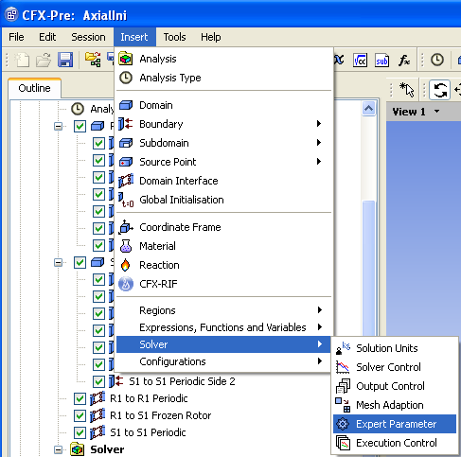
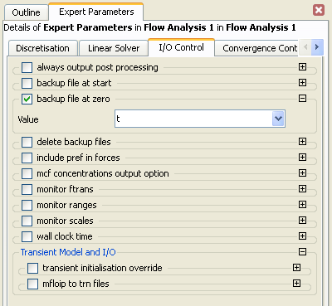
Setting Expert Parameters
Expert Parameter can be set in CFX-Pre, or by editing the CCL
In CFX-Pre: Inset > Solver > Expert Parameter
  Most, but not all Expert Parameters are shown in CFX-Pre

Slide 16
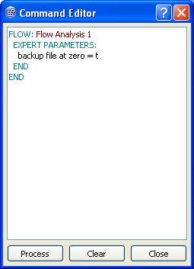
Setting Expert Parameters
In CCL add the EXPERT PARAMETER: object under the FLOW: object and type in the parameter
You can use the Command Editor in CFX-Pre (Tools > Command Editor) to type in CCL

Slide 17
Mesh Refinement Studies
Errors in a converged solution arise from:
  Numerical Errors
    E.g. round-off errors, convergence (lack-of) errors
  Model Errors
    E.g. accuracy of boundary conditions, physical models
  Discretization Errors
    Errors arising from converting the continuous governing equations into a discrete form that can be solved on a computer
Discretization errors reduce with mesh spacing
Mesh refinement studies are used to estimate the significance of discretization errors on your solution
Mesh refinement studies are recommended for each new type of simulation you perform

Slide 18
Mesh Refinement Studies
A mesh refinement study consist of solving the same case on progressively finer meshes
  Each mesh should be significantly finer than the previous, e.g. 100k nodes, 200k nodes, 400k nodes
The quantities of interest should be evaluated and compared for each mesh
  When the quantity reaches a steady value discretization errors are no longer significant
Quantity of Interest
Appropriate mesh
# of Elements

